Slide 1
SEMINAR PRESENTATION
ON
MOLECULAR MECHANISM OF HEAVY METAL TOXICITY IN HUMANS AND BIOMATERIAL-BASED THERAPEUTIC STRATEGIES
By
OKWURU, JENNIFER UKAH
25010101020
SUPERVISOR: DR. ADEBAMI GBOYEGA
Co supervisor: dr. fagbenro silas olakunle

Slide 2
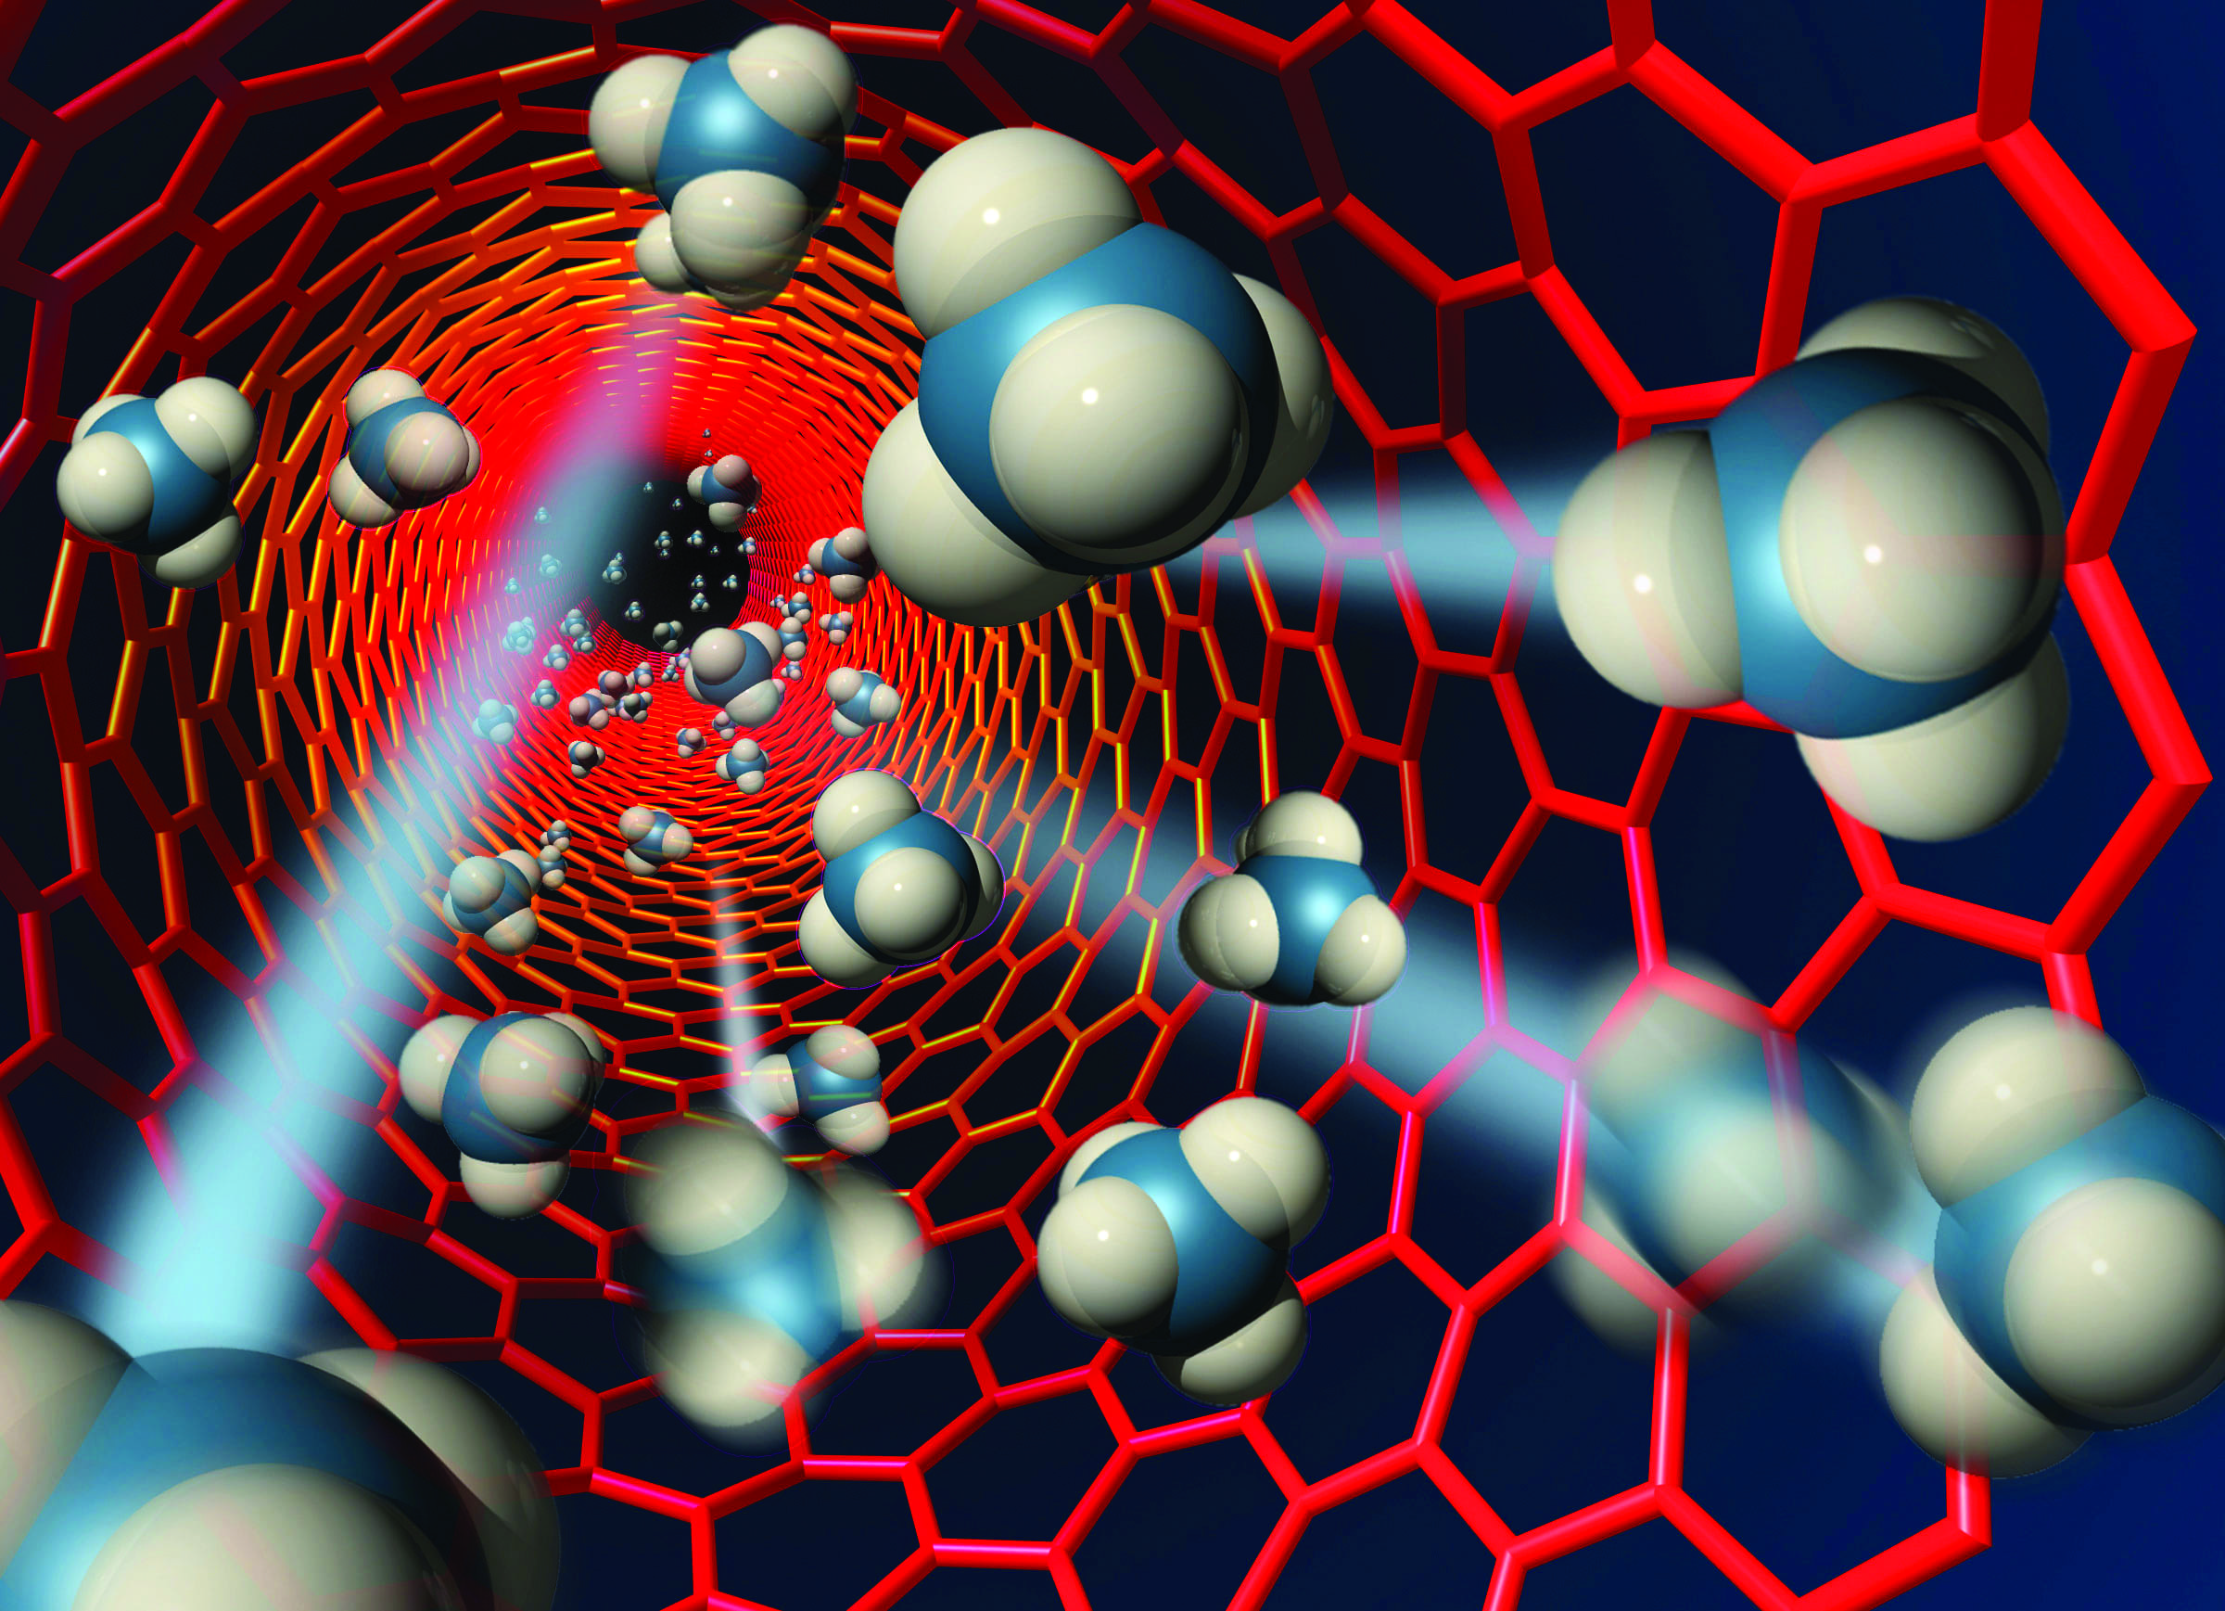
OUTLINE
Introduction
Why heavy metals are dangerous
Common Toxic Heavy Metals
Sources and Routes of Exposure
Molecular mechanisms of Toxicity
Therapeutic Strategies
Challenges & future perspectives
Conclusion
References
Zhao, J. (2009). Turning to nanotechnology for pollution control:
Applications of nanoparticles. Dartmouth Undergraduate
Journal of Science.

Slide 3
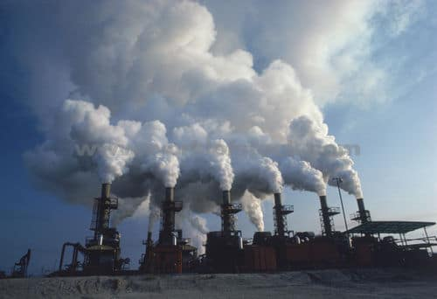

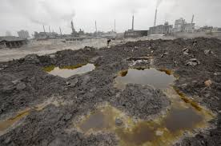
INTRODUCTION
Heavy metals are naturally occurring metallic elements with high density that can be toxic to living organisms even at low concentrations. They constitute environmental pollutants (Jomova et al., 2025).
They accumulate in human tissues and disrupt cellular functions (Kim et al., 2022).
The human exposure is increasing globally due to industrialization and pollution (Singh et al. 2024).
They Cause severe health complications (Jomova et al., 2025)
umert
Figure1-3. Environmental pollution of heavy metals from industrial
wastes

Slide 4
WHY HEAVY METALS ARE DANGEROUS
Heavy metals are hazardous because they are non-biodegradable and persist in the environment for long periods.
They accumulate in human tissues and increase in concentration through food chains, leading to chronic toxicity, organ damage and serious health disorders even at low exposure levels. (Rajput et al., 2024)
Effects:
Oxidative stress
Organ damage
Cancer
Neurological disorder
Figure 4: showing effects of heavy metals
Adapted from; (Mishra et al., 2022)

Slide 5
COMMON TOXIC HEAVY METALS
Heavy metals | Source | Toxic effects
Lead | Batteries | Neurotoxicity
Mercury | Seafood | Brain damage
Cadmium | Cigarettes | Kidney damage
Arsenic | Groundwater | Cancer
Chromium | Industries | DNA damage
Copper | Industrial discharge | Liver damage
Zinc | Industrial waste | Immune dysfunction
Batteries
Seafood
Cigarettes
Groundwater
Industries
Neurotoxicity
Brain damage
Kidney damage
Cancer
DNA damage
(Kim et al., 2022; Jomova et al., 2025)

Slide 6
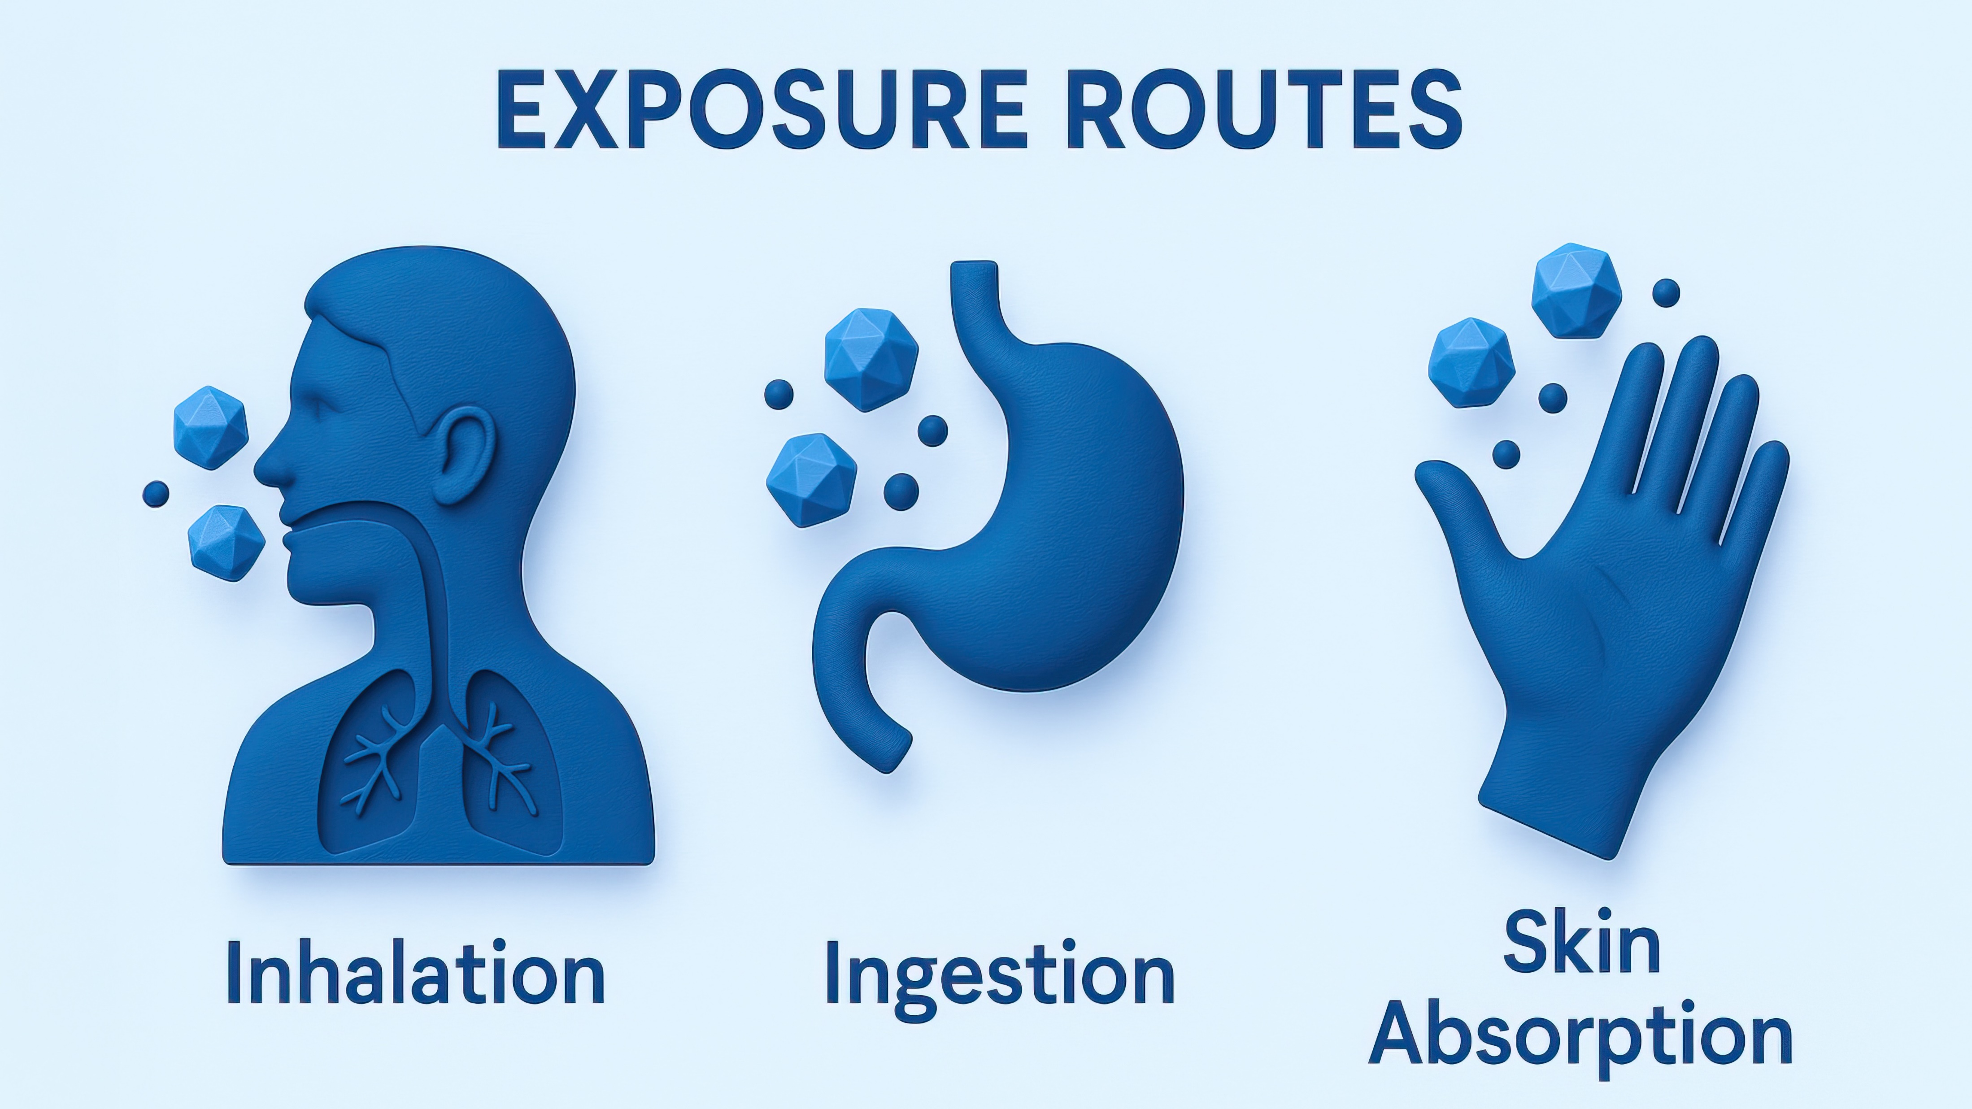
SOURCES & ROUTES OF EXPOSURE
Sources
Industrial emissions
Mining activities
Contaminated water
fertilizers/pesticides
Cigarette smoke
Electronic waste
Routes of Exposure
Inhalation
Ingestion
Dermal absorption
Figure 5. showing routes of exposure
Source: National institute for occupational safety health(2024)
(Singh et al., 2024)

Slide 7
MOLECULAR MECHANISMS OF TOXICITY
Central mechanism flowchart
Heavy metals exert toxicity through several molecular mechanisms, including reactive oxygen species (ROS) generation leading to oxidative stress, antioxidant depletion, enzyme inhibition, DNA damage, inflammation and apoptosis(Wang et al., 2024).
These processes disrupt normal cellular functions and contribute to tissue injury and organ dysfunction (Jomova et al., 2025)
Antioxidant depletion enzyme inhibition
DNA damage
Mitochondrial damage Inflammation
Heavy Metal Exposure
(Pb, Hg, Cd, As, Cr)
↓
ROS Generation
↓
Oxidative stress
↓
↓
Apoptosis/Cell death
↓
Organ dysfunction
(Wang et al., 2024; jomova et al., 2025)

Slide 8
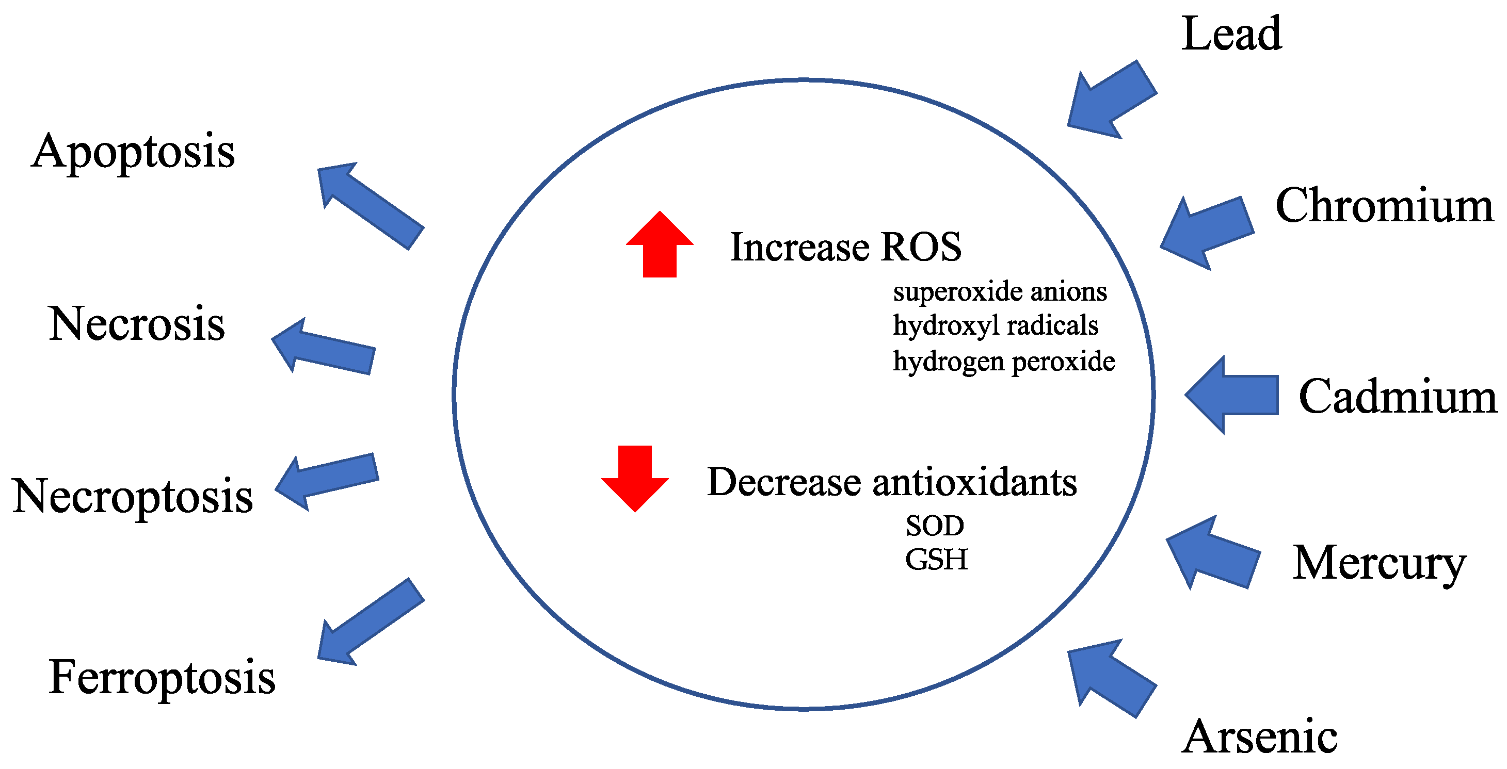
MOLECULAR MECHANISM OF TOXICITY
OXIDATIVE STRESS & MITOCHONDRIAL DAMAGE
Heavy metals stimulate excessive production of reactive oxygen species (ROS), leading to oxidative stress and cellular injury. Increased ROS damages lipids, proteins and DNA, while also impairing mitochondrial function (Jomova et al., 2025).
Mitochondrial damage reduces ATP production, disrupts energy metabolism and triggers apoptosis (programmed cell death), contributing to organ toxicity and tissue degeneration (Kim et al., 2022).
Figure 6. Role of oxidative stress in heavy metal induced mitochondrial damage. Source: (Kim et al., 2022)

Slide 9
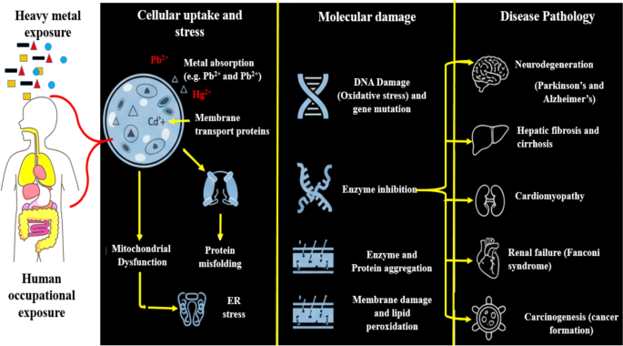
MOLECULAR MECHANISM OF TOXICITY
DNA DAMAGE & INFLAMMATION
Heavy metals induce DNA strand breaks, gene mutations, and epigenetic alterations that may contribute to carcinogenesis (Manic et al., 2022)
They also activate inflammatory pathways such as NF-KB and cytokine release, resulting in chronic inflammation, cellular injury and tissue degeneration (Coradduzza et al., 2024).
Figure 7: molecular toxicity of heavy metal exposure
(Narayanan, 2026)

Slide 10
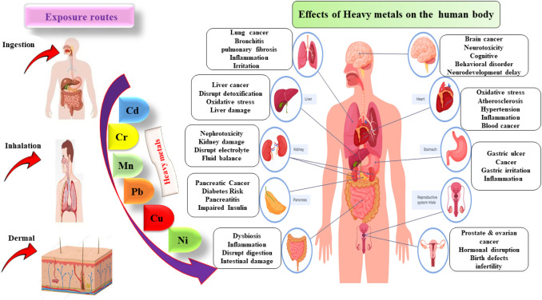
ORGAN-SPECIFIC TOXICITY
Organs affected:
Brain → Neurotoxicity
Liver → Hepatoxicity
Kidney →Nephrotoxicity
Heart →Cardiovascular toxicity
Blood → Anemia
Reproductive organ→ Infertility
(Nafeesa et al., 2024)
Figure 8: Showing the organ-specific toxicity of heavy metals
(Nafeesa et al., 2024)

Slide 11
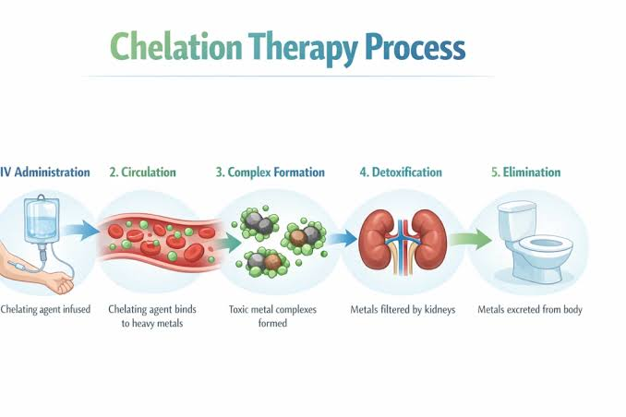
THERAPEUTIC STRATEGIES FOR MANAGING HEAVY METAL TOXICITY
Chelation therapy: This is a medical treatment that removes heavy metals from the body using special binding agents. Chelators include Ethylenediaminetetraacetic acid (EDTA), Dimercatosuccinic acid (DMSA), Dimercaprol.
Limitations: Side effects, poor specificity, mineral depletion.
(Kim et al., 2022)
Antioxidant therapy: They neutralize ROS and reductive oxidative stress caused by metal exposure. Common antioxidant agents include glutathione, melatonin, acetylcysteine (Koyama et al., 2024).
Figure 9: the process of chelation therapy
(Tigris Valley, 2026)

Slide 12
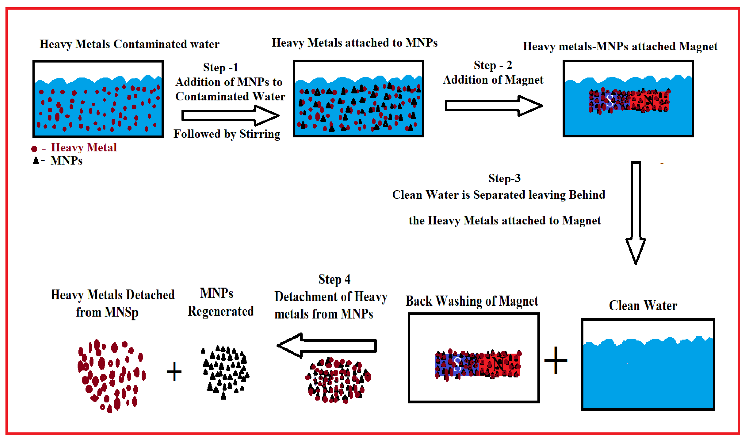
THERAPEUTIC STRATEGIES FOR MANAGING HEAVY METAL TOXICITY
Biomaterials: They are natural or synthetic materials designed to interact safely with living tissues for medical or environmental applications. They include nanoparticles, liposomes, hydrogels, biosorbents (through adsorption and ion exchange mechanism).
Advantages: Targeted detoxification, reduced toxicity(Abbas et al., 2023)
Nanotechnology: This is the science and application of materials and devices at the nanoscale to improve products and solve problems in medicine, industry and the environment (Kim et al., 2022).
Figure 10: Schematic representation of the working steps
for water cleaning using MNPs. (Hussien et al., 2022)

Slide 13
CHALLENGES AND FUTURE PERSPECTIVES
Challenges:
Despite promising advances, biomaterial-based therapies for heavy metal detoxification face challenges including toxicity concerns, poor biocompatibility, high production costs and limited clinical trials. Regulatory and safety issues also restrict large-scale medical application. (Olawade et al., 2024)
Future:
Future research is focused on developing smart nanoparticles, ROS-responsive biomaterials and precision medicine approaches for safer, targeted and more effective detoxification strategies. (Zang et al., 2024; Wang et al., 2024)

Slide 14
CONCLUSION
Heavy metal toxicity remains a major environmental and public health concern due to its harmful effects on human cells and tissues. Biomaterial-based therapeutic strategies have emerged as promising approaches for targeted detoxification and improved treatment efficiency. Nevertheless, additional research and clinical validation are required to confirm their safety, effectiveness and long-term applicability in human health management.

Slide 15
REFERENCES
Abbas, M., Khan, M. A., & Ahmed, S. (2023). Journal of Environmental Chemical Engineering, 11(4), 110234.
Jomova, K., Alomar, S. Y., Nepovimova, E., Kuca, K., & Valko, M. (2025). Archives of Toxicology, 99, 153–209.
Kim, J. J., Kim, Y. S., & Kumar, V. (2022). Journal of Trace Elements in Medicine and Biology, 68, 126845.
Sheraz, N., Shah, A., Haleem, A., & Iftikhar, F. J. (2024). RSC Advances, 14, 11284–11310.
Singh, V., Ahmed, G., Vedika, S., et al. (2024). Scientific Reports, 14, 7595.
Wang, Y. L., Lee, Y. H., Chou, C. L., et al. (2024). Environmental Pollution, 346, 123617.
Zhang, Y., Jiang, M. J., & Wang, T. W. (2024). Frontiers in Bioengineering and Biotechnology, 12, 1469393.

Slide 16
Thank you

